Slide 1

Natural Language Processing Oleksandr Krakovetskyi CEO, DevRain Solutions @msugvnua, alex.krakovetskiy@devrain.com https://www.facebook.com/alex.krakovetskiy

Slide 2
About
CEO of DevRain Solutions (software development company).
CTO DonorUA/Udonors.
Microsoft Regional Director.
Microsoft Most Valuable Professional.
Best Professional in Software Architecture (Ukrainian IT Award).
Ph.D. in Computer Science.
Community lead in Kyiv Smart City initiative, expert in Open Data.
Speaker and IT blogger.

Slide 3
What’s Text Mining?
Text mining refers to the process of deriving high-quality information from text. 'High quality' in text mining usually refers to some combination of relevance, novelty, and interestingness. Typical text mining tasks include text categorization, text clustering, concept/entity extraction, production of granular taxonomies, sentiment analysis, document summarization, and entity relation modeling (i.e., learning relations between named entities).

Slide 4
Natural Language Processing
Natural language processing is a field of computer science, artificial intelligence, and computational linguistics concerned with the interactions between computers and human (natural) languages.
Many challenges in NLP involve: natural language understanding, enabling computers to derive meaning from human or natural language input; and others involve natural language generation.

Slide 5
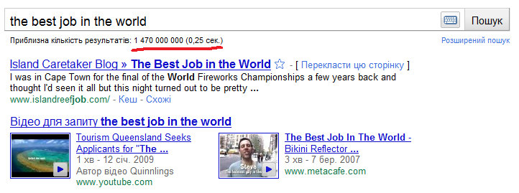
#1: Quick Search of Information
“No information” problem is transformed to the “a lot of information” problem.
Amount of information increases every year in geometric progression.
Big data.

Slide 6
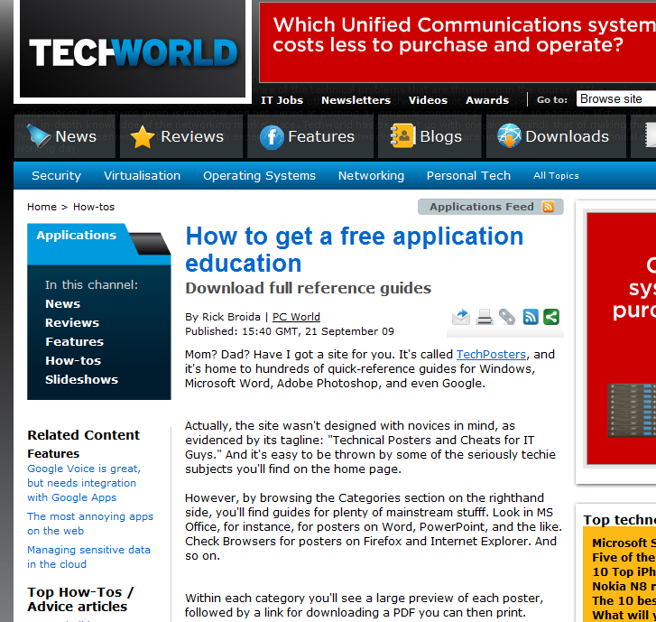
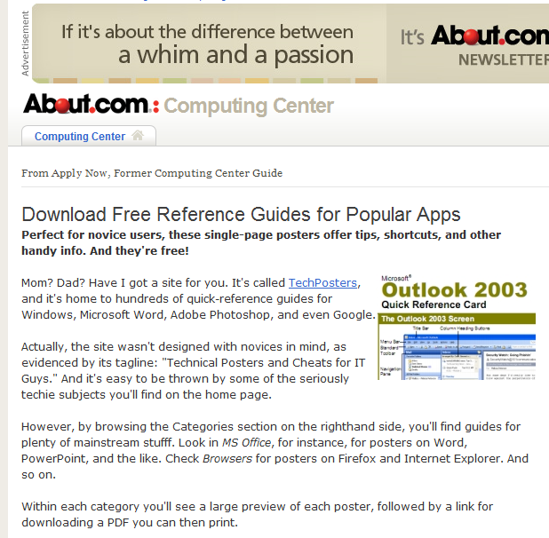
#2: Duplicates
Different chrome not the content.
Copyrighting and plagiarism.
Partially solved for news.

Slide 7
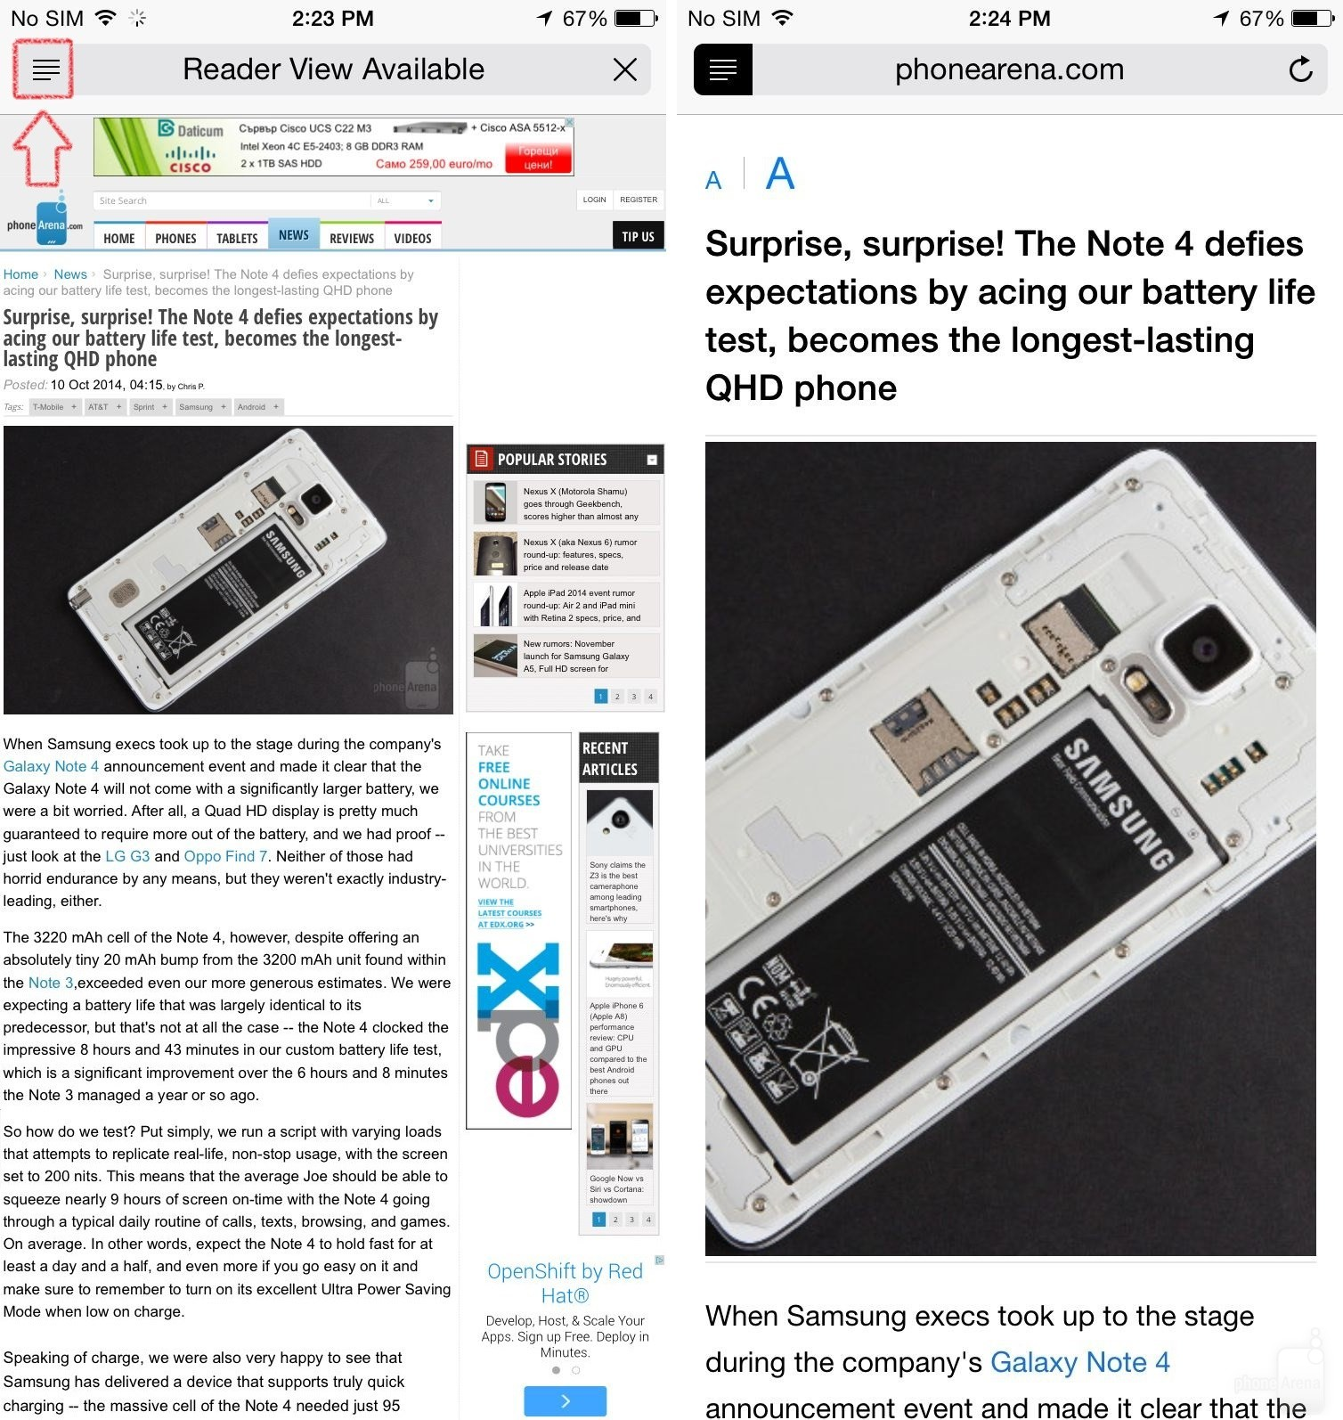
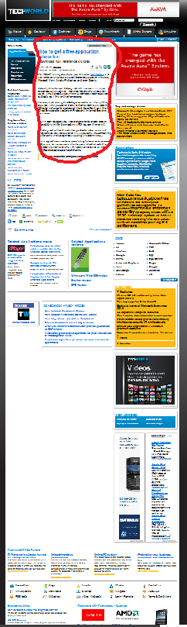
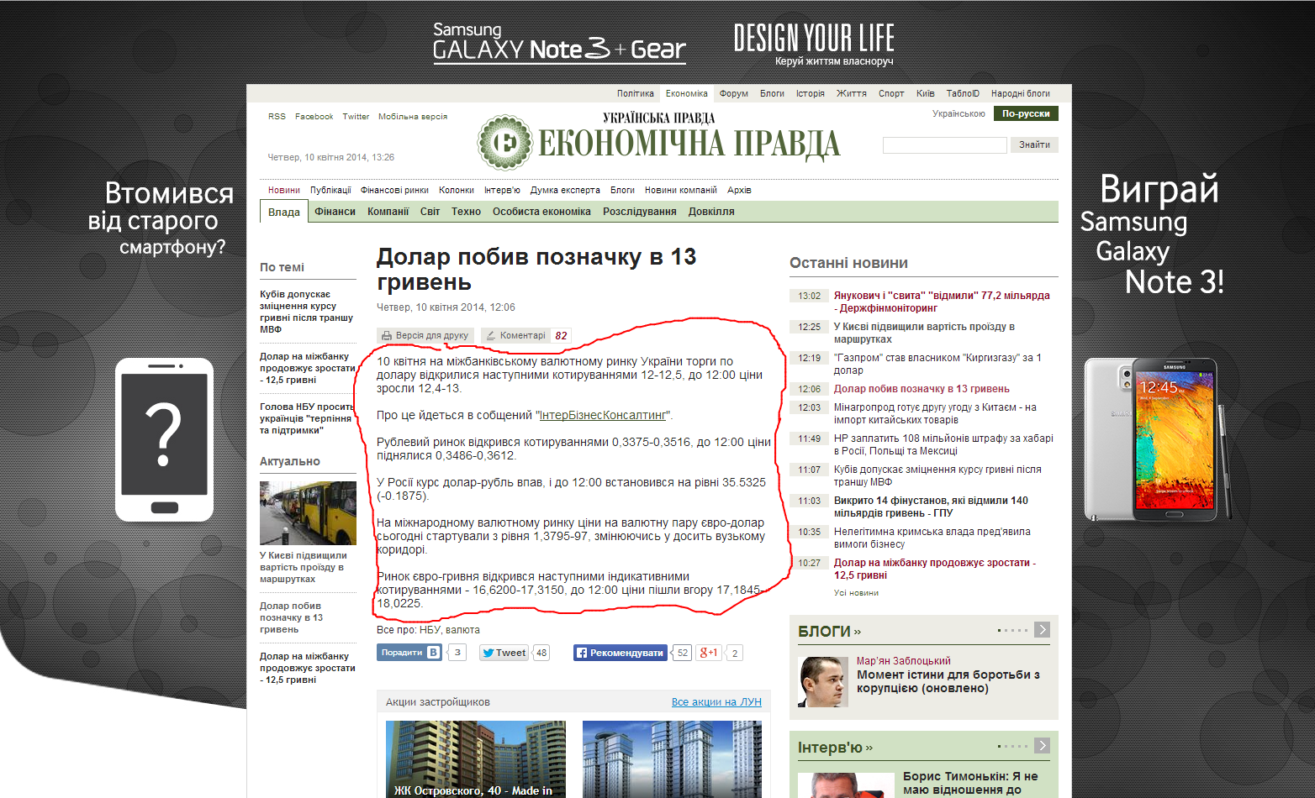
#3: Information waste
Level 1: noisy information such as advertisement, copyright, decoration, etc.
Level 2: useful information, but not very relevant to the topic of the page, such as navigation, directory, etc.
Level 3: relevant information to the theme of the page, but not with prominent importance, such as related topics, topic index, etc.
Level 4: the most prominent part of the page, such as headlines, main content, etc.

Slide 8
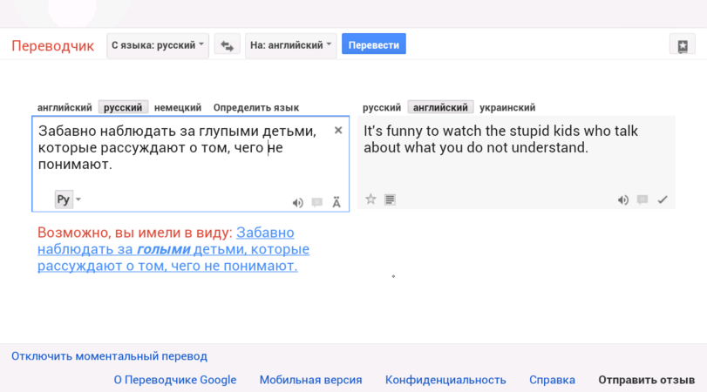
#4: Translation

Slide 9
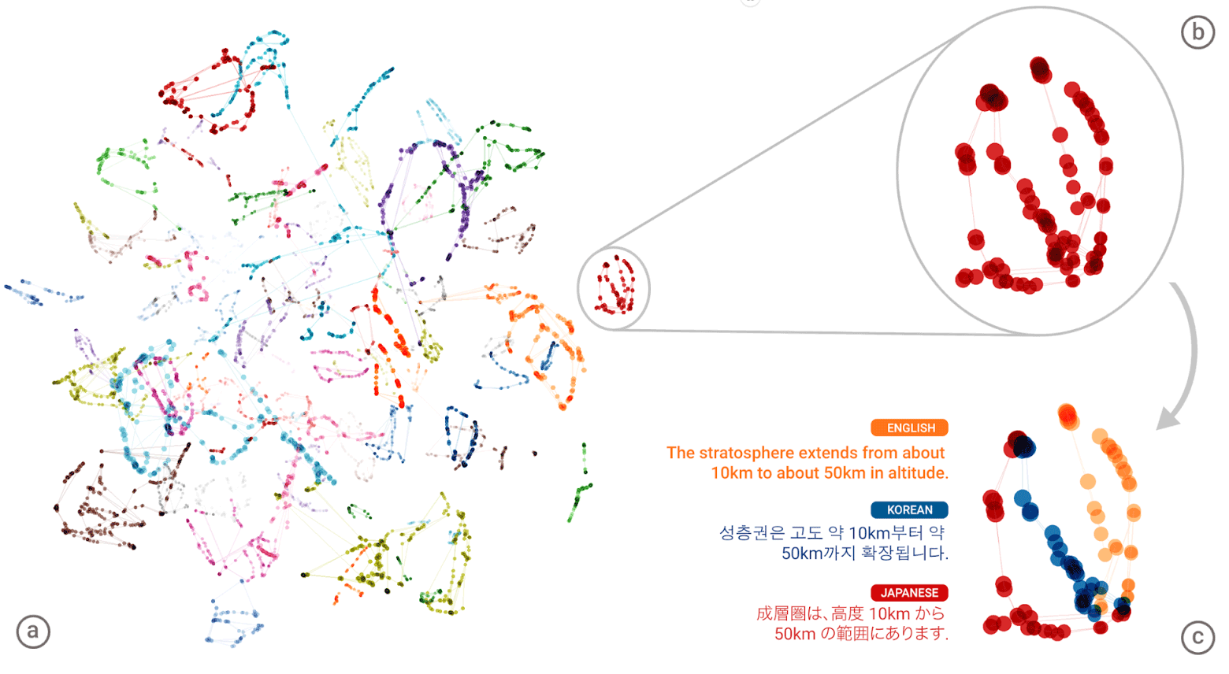
#4: GNMT
Google Neural Machine Translation (GNMT)
https://geektimes.ru/post/282976/

Slide 10
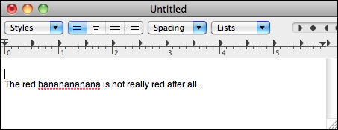
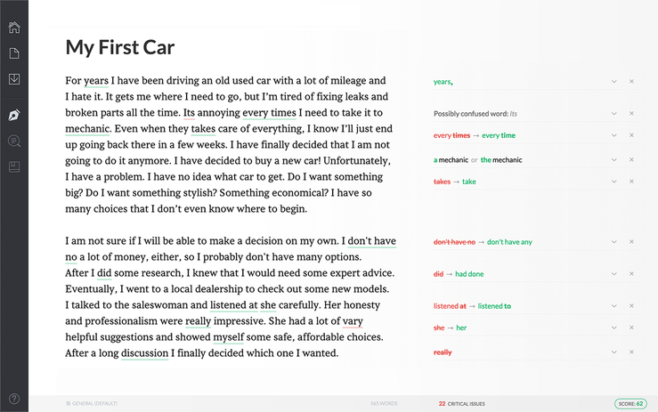
#5: Grammar and Spell Check

Slide 11
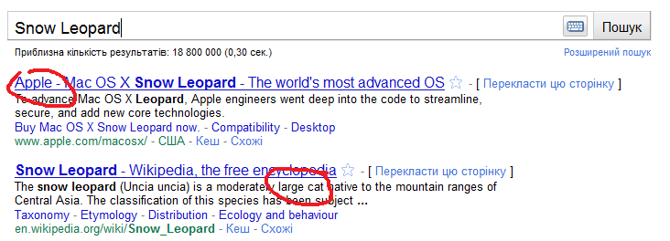
#6: Clustering and Categorization
“Snow Leopard”
Can be “cat” or “operation system” from Apple.

Slide 12
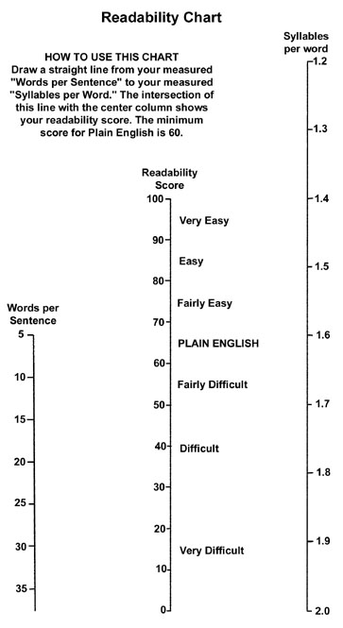
#7: Readability Score
Readability is the ease with which a reader can understand a written text. In natural language, the readability of text depends on its content (the complexity of its vocabulary and syntax) and its presentation (such as typographic aspects like font size, line height, and line length).

Slide 13

Semantic Web
The Semantic Web is an extension of the Web through standards by the World Wide Web Consortium (W3C). The standards promote common data formats and exchange protocols on the Web, most fundamentally the Resource Description Framework (RDF).

Slide 14
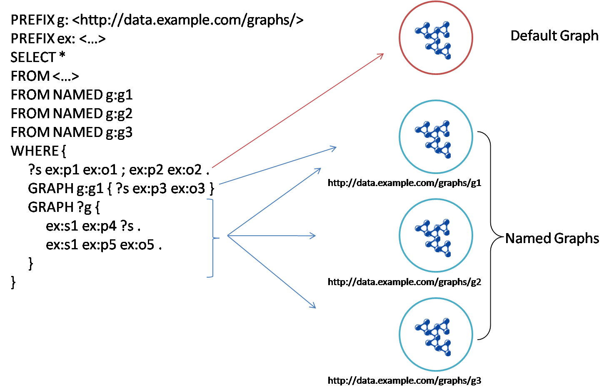
RDF & SPARQL
SPARQL is an RDF query language, that is, a semantic query language for databases, able to retrieve and manipulate data stored in Resource Description Framework (RDF) format.

Slide 15
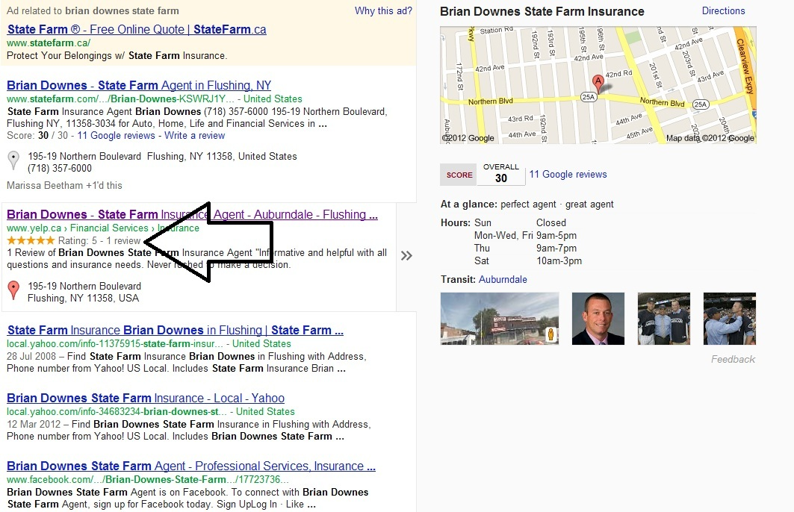
Microformats
Designed for humans first and machines second, microformats are a set of simple, open data formats built upon existing and widely adopted standards.
http://microformats.org/
Schema.org is a collaborative, community activity with a mission to create, maintain, and promote schemas for structured data on the Internet, on web pages, in email messages, and beyond.
http://schema.org/

Slide 16
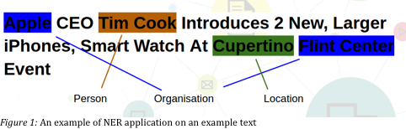
Named Entity Recognition
Subtask of information extraction that seeks to locate and classify named entities in text into pre-defined categories such as the names of persons, organizations, locations, expressions of times, quantities, monetary values, percentages, etc.

Slide 17
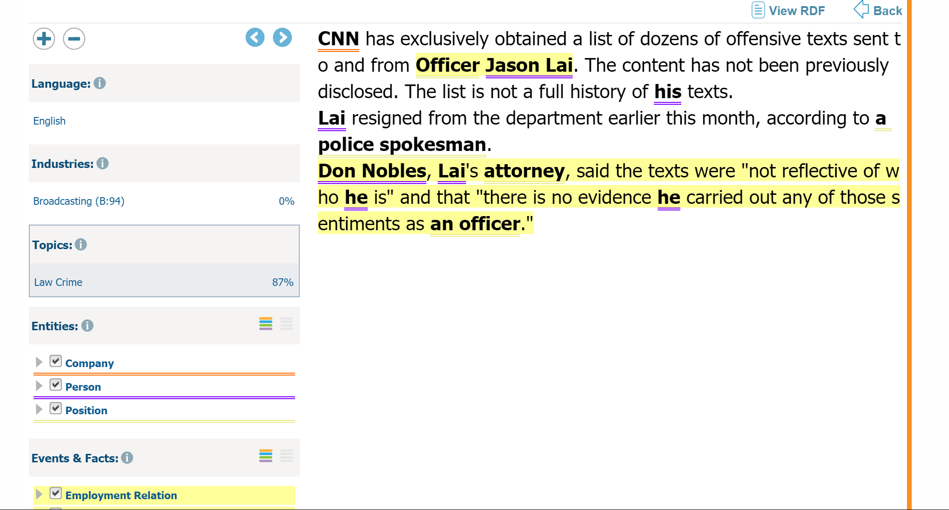
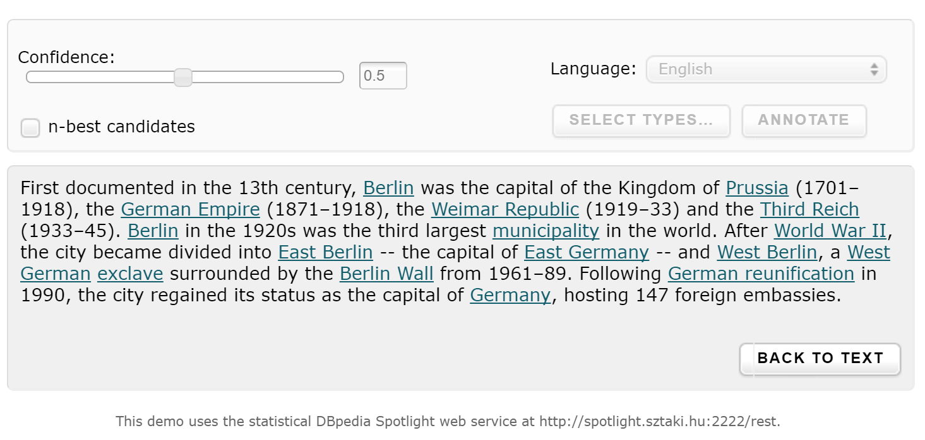
OpenCalais & Dbpedia Spotlight

Slide 18
Reuters Corpora
As a service to the scientific community, Reuters is making available large quantities of Reuters News stories for research into natural language processing, information retrieval, machine learning, etc.
http://about.reuters.com/researchandstandards/corpus/

Slide 19
NER Tools
http://msg.ai/
OpenCalais https://www.opencalais.com/opencalais-demo/
Dbpedia Spotlight
AlchemyAPI
BitextAPI https://www.bitext.com/text-analysis-api/
CogitoAPI http://www.cogitoapi.com/
Entitizer (Romanian, Russian, Bulgarian, Hungarian) http://klangoo.com/search.aspx
Magnet by Klangoo (40+ languages, including Klingon ...) http://klangoo.com/search.aspx
MeaningCloud http://www.meaningcloud.com/
Ingen.io https://www.quora.com/topic/Ingen-io
Rosette (many European, Middle Eastern and Asian langauges) https://developer.rosette.com/
Saplo https://www.quora.com/topic/Saplo-company
Semantria https://www.quora.com/topic/Semantria
Aylien.com http://aylien.com/
TextRazor https://www.textrazor.com/
Wolfram Alpha https://www.wolframalpha.com/
Microsoft Cognitive Services & Azure ML https://www.microsoft.com/cognitive-services/en-us/apis

Slide 20
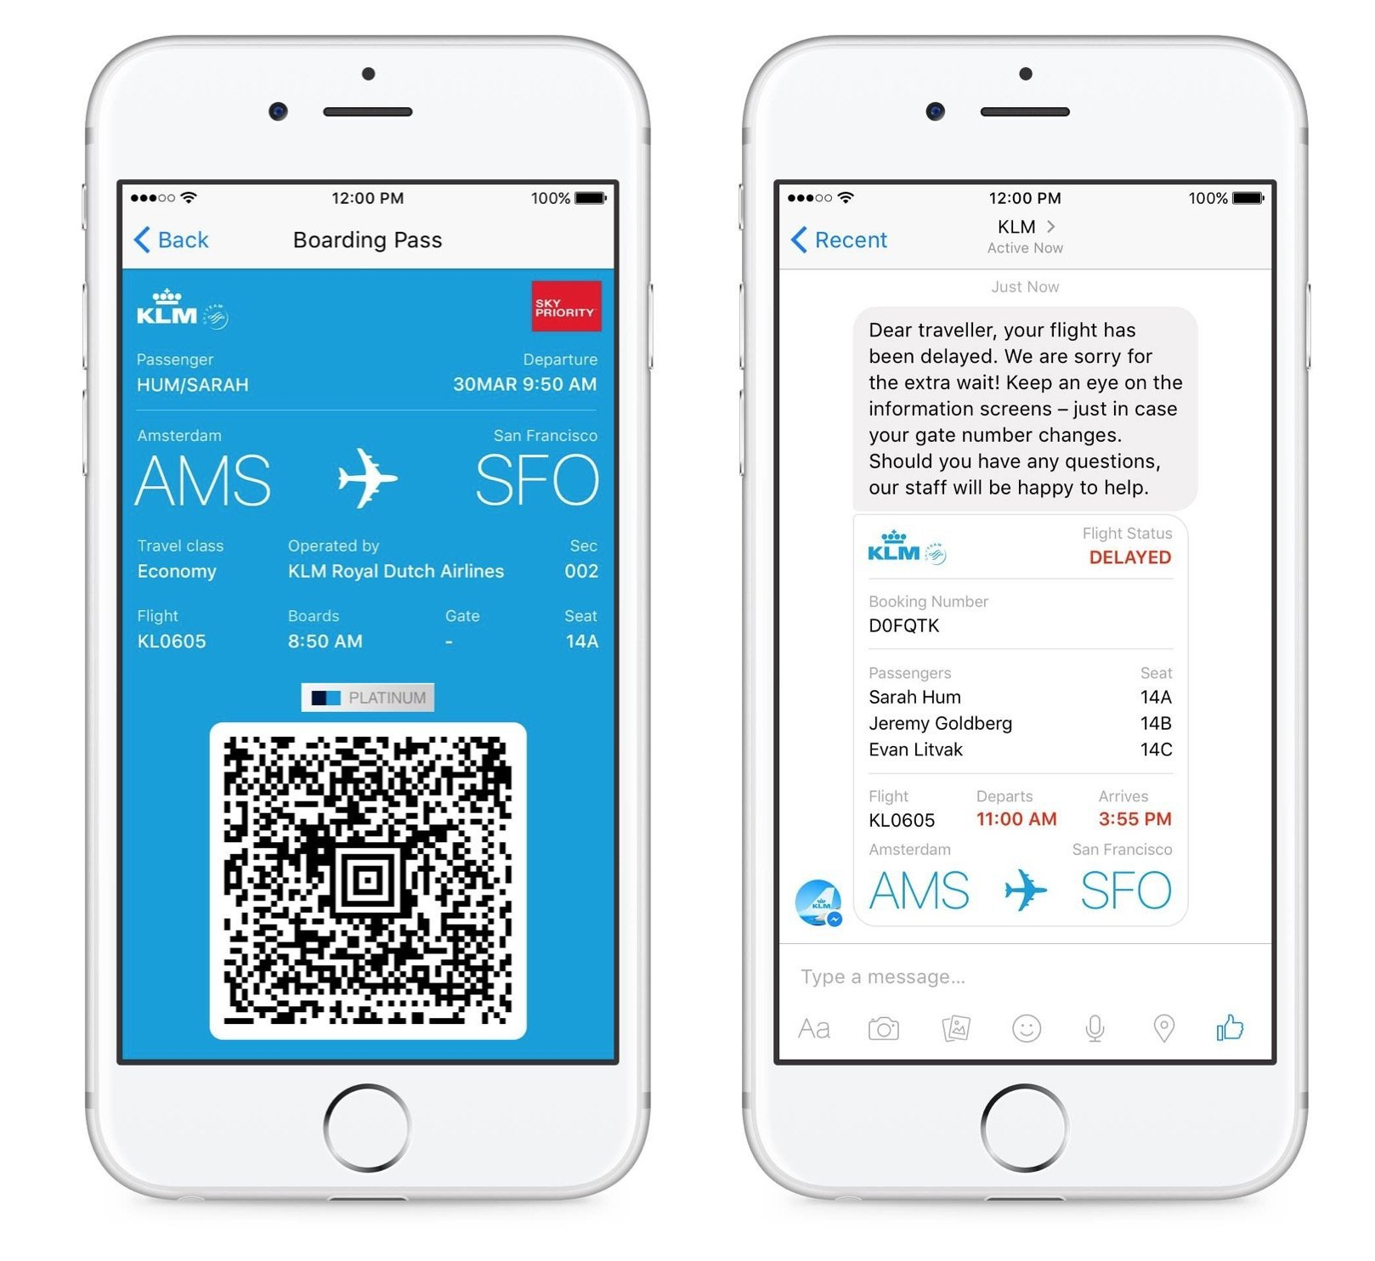
Chatbots
Chatter robot is a type of conversational agent, a computer program designed to simulate an intelligent conversation with one or more human users via auditory or textual methods.

Slide 21
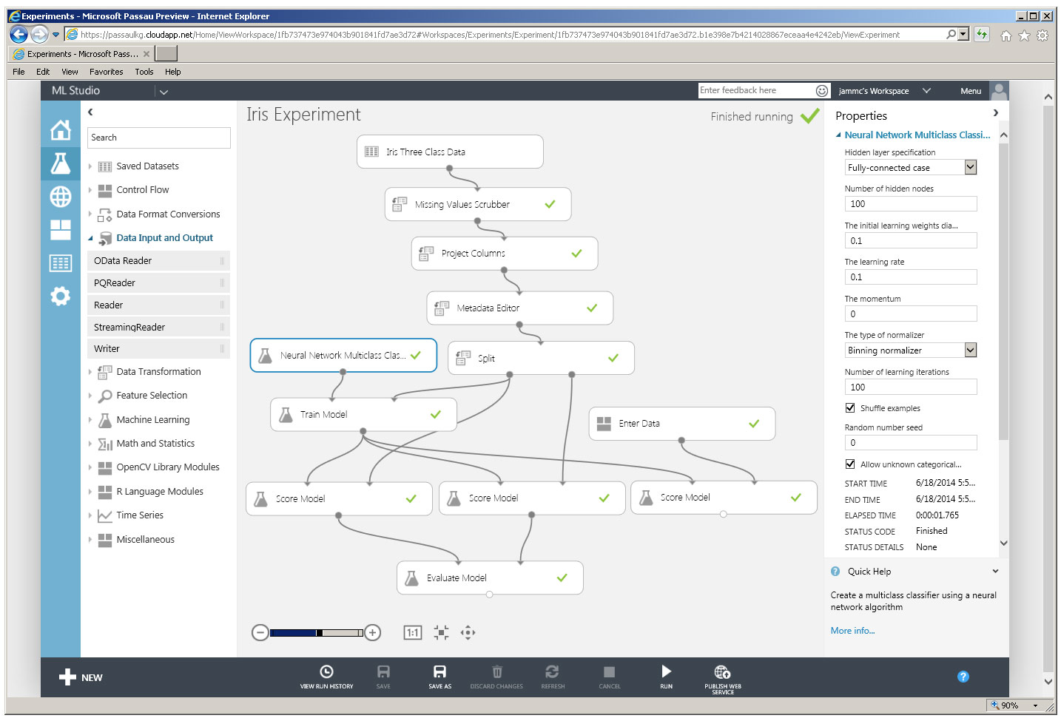
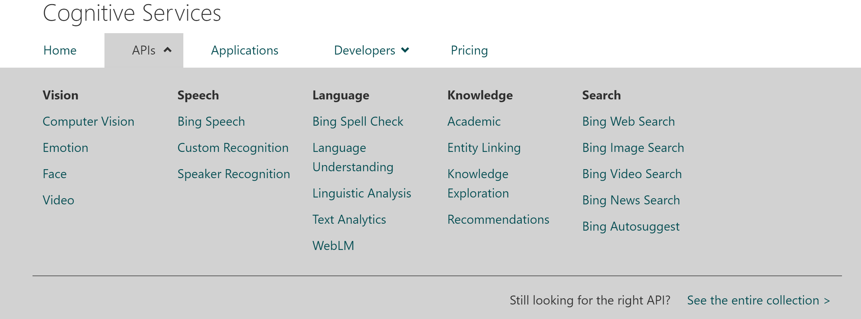
Microsoft Cognitive Services & ML

Slide 22
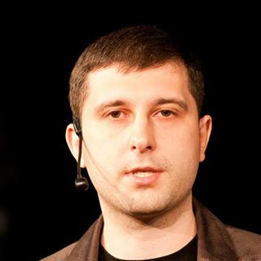
Q&A
Oleksandr Krakovetskyi
CEO DevRain Solutions
alex.krakovetskiy@devrain.com
@msugvnua
https://www.facebook.com/alex.krakovetskiy

